Slide 1
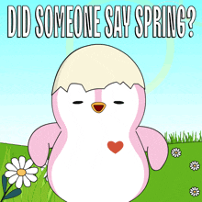
Welcome to our Spring Assembly
Blackhall St Columba’s Church
Thursday, 3rd April 2025
Notes:
Isla - Welcome to our Parents and Carers who have joined us this morning for our assembly. It is so nice to have you with us and we hope you will enjoy your time here.
Lewis – Now Fergus will offer his own welcome.

Slide 2

Welcome!
Rev. Fergus Cook

Slide 3

Song – Spring is Here
Notes:
Lewis – Thank you Fergus.
We are going to kick off this morning with one of our favourite Spring Songs. Please join in, parents and carers!
Spring is Here!

Slide 4
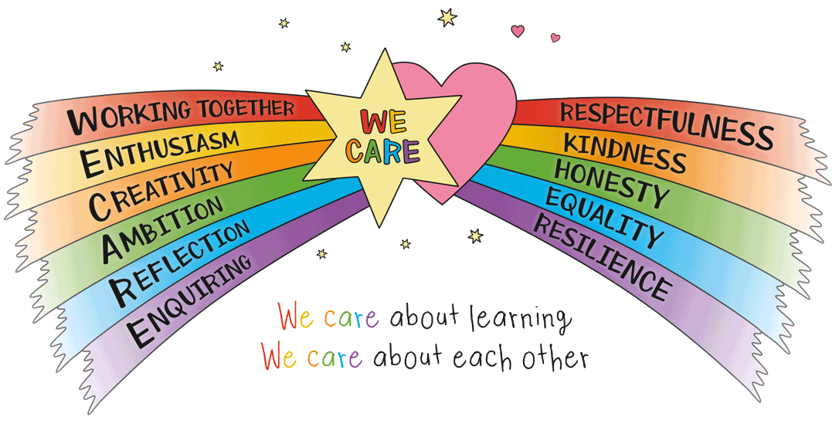
At Blackhall, we value:
Respect; Creativity; Resilience; Ambition; Responsibility
Notes:
Ruby - Values are more than words – they are behaviours. We have to show them in what we do.
Isla - We like to think this is how we represent ourselves, our school and community and we do this without being reminded.

Slide 5
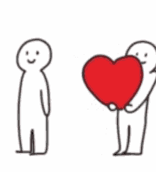
This Spring, we have been thinking about Giving
Notes:
Gus – Our values of respect and responsibility have been demonstrated when we have been thinking about giving for this time of year. We are giving in the lead up to Easter:
Giving of our time and talents.

Slide 6
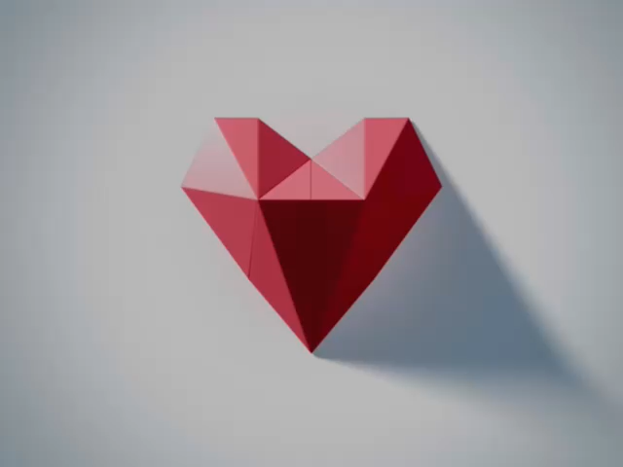
“Why is it Good to Give?”
Notes:
Kyla – P7s asked the question, “Why is it good to give?”
We made a movie of everyone’s responses. Are you in it??
Theo – We would now like to share a story about GIVING. We hope you enjoy it!

Slide 7
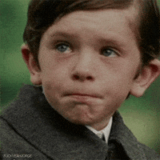
“Giving is Better” –
A Story Told by P7 at Blackhall
Sometimes we are selfish and don’t even know it.
Sometimes we’re not happy and don’t want to show it.
Notes:
Olivia

Slide 8
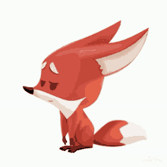
“Giving is Better” –
A Story Told by P7 at Blackhall
Katie the Fox was both of these things.
And when she saw others happy, it would make her heart sting.
Notes:
Olivia

Slide 9
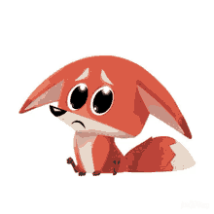
“Giving is Better” –
A Story Told by P7 at Blackhall
She thought, “Why is it so?”
I can’t seem to see
Why happiness found them
And hasn’t found me
Notes:
Olivia and Katie

Slide 10

Giving is Better –
A Story Told by P7 at Blackhall
Maybe it’s this – I know what to do
If I find what they have
I’ll find happiness too.
Notes:
Katie

Slide 11
“Giving is Better” –
A Story Told by P7 at Blackhall
So she set out to find what it was that they had
And soon she would know what was making them glad.
Notes:
Olivia

Slide 12
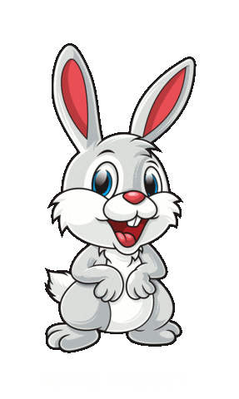
“Giving is Better” –
A Story Told by P7 at Blackhall
First she came across Lucy – a kind bunny rabbit,
And when it came to happiness, there was no doubt she had it.
Notes:
Rosie

Slide 13
“Giving is Better” –
A Story Told by P7 at Blackhall
First she asked, “Miss Lucy, my neighbour and friend…
What makes you so happy from day’s start to its end?”
Notes:
Rosie and Katie

Slide 14
“Giving is Better” –
A Story Told by P7 at Blackhall
“Oh Katie, my girl,” Lucy said with a smile,
“If I gave all the reasons, it would sure take a while.
Notes:
Lucy and Rosie

Slide 15
“Giving is Better” –
A Story Told by P7 at Blackhall
But here is just one of the things I love most:
Take my very best carrot and now listen close…”
Notes:
Lucy

Slide 16
“Giving is Better” –
A Story Told by P7 at Blackhall
Giving is better, much better than getting,
I know it may not seem true
But just try it once and you’ll find what you’re missing;
That giving is better for me and for you.
Notes:
All singing

Slide 17
“Giving is Better” –
A Story Told by P7 at Blackhall
Katie ran off thinking,
“That must be wrong!
Giving is better?
What an odd silly song.”
Notes:
Rosie and Katie

Slide 18


Top of the Food Chain!
Notes:
Robbie – While Katie is thinking about that, we will take some time to revisit our show, earlier this term. “What’s the Crime Mr Wolf” was performed to a packed audience at Royal High School.
Our teachers wanted us to sing 2 of their favourite songs from this show.
Ewan - Our P7 year group is going to come up and perform now. Have we remembered them? Let’s find out!
“Top of the Food Chain”
“The Wildest Song”

Slide 19

The Wildest Song
Notes:
Robbie – Well, it looks like we remembered them pretty well.
Now let’s get back to our story and find out how Katie the Fox is progressing…

Slide 20
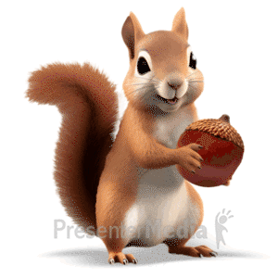
“Giving is Better” –
A Story Told by P7 at Blackhall
Next thing she knew, Katie ran into, “Me!”
Daphne, the squirrel whose smile brought such glee.
Notes:
Joshua and Daphne

Slide 21
“Giving is Better” –
A Story Told by P7 at Blackhall
“Daphne, please tell,”
Katie began enquiring,
“How can it be that you never stop smiling?”
Notes:
Joshua and Katie

Slide 22
“Giving is Better” –
A Story Told by P7 at Blackhall
“It’s simple, my friend,”
Daphne quickly replied,
“I’m thankful for all that I have in my life.
Notes:
Joshua and Daphne

Slide 23
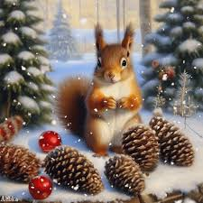
“Giving is Better” –
A Story Told by P7 at Blackhall
Now have some of my pine cones;
I have plenty, you see.
I’ve got less than I want
But more than I need.
Notes:
Daphne

Slide 24
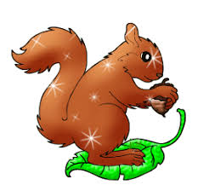
“Giving is Better” –
A Story Told by P7 at Blackhall
Giving is better, much better than getting,
I know it may not seem true
But just try it once and you’ll find what you’re missing;
That giving is better for me and for you.
Notes:
All sing

Slide 25
“Giving is Better” –
A Story Told by P7 at Blackhall
As Katie kept going, she thought like before,
“How can giving be better?
Is less somehow more?”
Notes:
Joshua and Katie

Slide 26
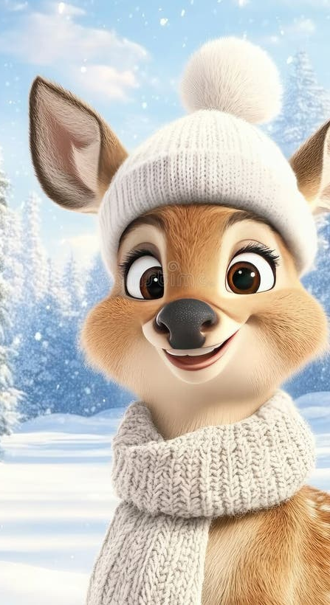
“Giving is Better” –
A Story Told by P7 at Blackhall
Then she ran into Ellis,
A most unselfish deer
Maybe he’d know the way
To help Katie’s fears
Notes:
Olivia

Slide 27
“Giving is Better” –
A Story Told by P7 at Blackhall
“Ellis, Please help me.
I can’t seem to find
Why everyone’s heart is more happy than mine.”
Notes:
Katie

Slide 28
“Giving is Better” –
A Story Told by P7 at Blackhall
Ellis responded with a big toothy grin
“I know what you’re seeking –
It’s something within.
Notes:
Olivia and Ellis

Slide 29
“Giving is Better” –
A Story Told by P7 at Blackhall
If you search your own heart, it will soon become clear
But take my hat and scarf as it’s quite cold out here.
Notes:
Ellis

Slide 30
“Giving is Better” –
A Story Told by P7 at Blackhall
As Katie was leaving, she heard Ellis sing too
“Giving is better for me and for you.”
Notes:
Olivia
Esme - And now we are going to do a bit of singing ourselves!
We are going to sing about Easter Jubilation.
Parents and carers, the words are on the screen – please join in!

Slide 31
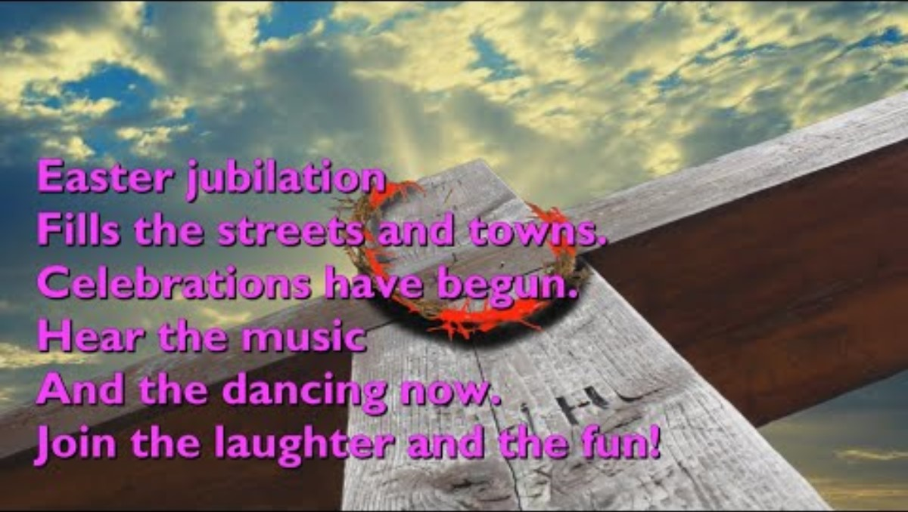
Easter Jubilation – Let’s sing together
Notes:
Esme - Thank you everyone! That was some lively singing.
Let’s head back to our story to see how Katie is getting on with her quest…

Slide 32
“Giving is Better” –
A Story Told by P7 at Blackhall
“I still don’t get it,”
Katie thought to herself
“I have all these nice gifts, but they just haven’t helped.”
Notes:
Rosie and Katie

Slide 33
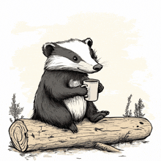
“Giving is Better” –
A Story Told by P7 at Blackhall
And finding no answer, Katie turned to go home
When she saw Libby, the Badger, looking sad and alone.
Notes:
Rosie

Slide 34
“Giving is Better” –
A Story Told by P7 at Blackhall
“Please tell me, Libby, why are you so sad?
Has something gone wrong that has made you feel bad?”
Notes:
Katie

Slide 35
“Giving is Better” –
A Story Told by P7 at Blackhall
“It’s nothing that happened,”
Libby said with a tear.
“It’s about all of the things that I’m missing right here.
Notes:
Libby and Rosie

Slide 36
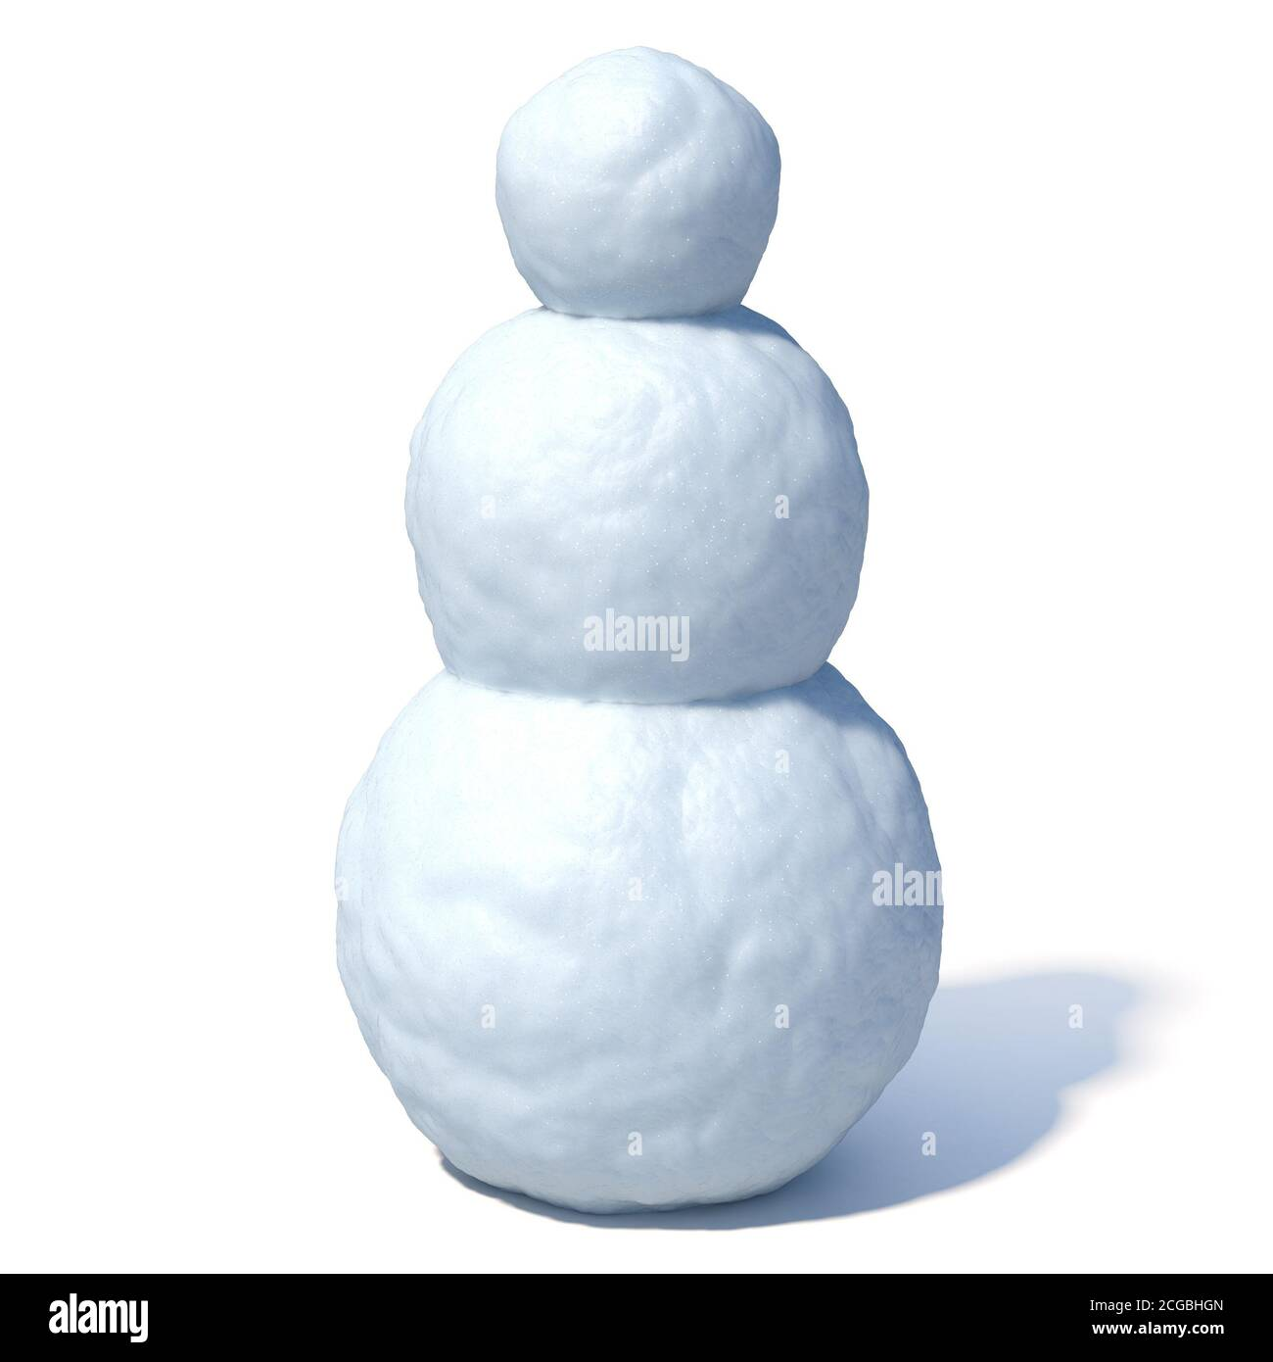
“Giving is Better” –
A Story Told by P7 at Blackhall
“You see, I’m building a snowman,
But I cannot proceed.
As I don’t have the things that a good snowman needs.”
Notes:
Libby

Slide 37
“Giving is Better” –
A Story Told by P7 at Blackhall
“So instead he’s just plain with no face to show.
He won’t be a real snowman,
Just 3 balls of snow.”
Notes:
Libby

Slide 38
“Giving is Better” –
A Story Told by P7 at Blackhall
Katie wished she could help,
But what could she do?
How could she make Libby happy if she was sad too?
Notes:
Rosie

Slide 39




“Giving is Better” –
A Story Told by P7 at Blackhall
Then Katie remembered
All the gifts in her pack!
And perhaps to be happy,
She should try giving back.
Notes:
Rosie

Slide 40
“Giving is Better” –
A Story Told by P7 at Blackhall
So she said to Libby,
“I think I’ve got what you need;
And all because others have been so kind to me!”
Notes:
Rosie and Katie

Slide 41



“Giving is Better” –
A Story Told by P7 at Blackhall
Katie gave Libby carrot, pine cones, hat and scarf.
Then she finished her snowman and it warmed both their hearts!
Notes:
Olivia

Slide 42
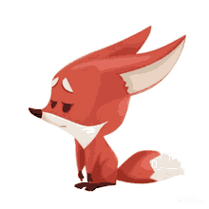
“Giving is Better” –
A Story Told by P7 at Blackhall
As she turned to go home, Katie felt kind of strange -
The sting in her heart had suddenly changed
Notes:
Olivia

Slide 43

“Giving is Better” –
A Story Told by P7 at Blackhall
Though her pack was now empty, her heart overflowed.
Was it the things she had given, or the kindness she’d shown?
Notes:
Olivia

Slide 44
“Giving is Better” –
A Story Told by P7 at Blackhall
Just then Katie realised
She had it all wrong -
Trying just to be happy kept her sad all along.
Notes:
Joshua

Slide 45
“Giving is Better” –
A Story Told by P7 at Blackhall
“Ellis was right,”
Katie thought with a smile.
“There is something within that I’ve had all the while.”
Notes:
Katie and Joshua

Slide 46

“Giving is Better” –
A Story Told by P7 at Blackhall
Well, Katie the fox was much happier now,
And when others asked why, she would sing to tell how,
Notes:
Olivia

Slide 47
“Giving is Better” –
A Story Told by P7 at Blackhall
Giving is better, much better than getting,
I know it may not seem true
But just try it once and you’ll find what you’re missing;
That giving is better for me and for you.
Notes:
All singing

Slide 48

Give a Little Bit
Notes:
Robbie – We hope you enjoyed our story and will remember that giving is much better than getting.
We have learned another song about giving. Let’s hear some of our amazing Blackhall voices!

Slide 49
Give a Little Bit - Lyrics
Give a little bit
Oh, give a little bit of your love to me
I'll give a little bit
I'll give a little bit of my love to you
There's so much that we need to share
So send a smile and show you care
I'll give a little bit
I'll give a little bit of my life for you
So give a little bi-i-i-t
Oh, give a little bit of your time to me
See the man with the lonely eyes
Oh, take his hand, you'll be surprised

Slide 50
Give a Little Bit - Lyrics
(now up)Give a little bit
Oh, give a little bit of your love to me
I'll give a little bi-i-i-t
I'll give a little bit of my life for you
Now's the time that we need to share
So find yourself, we're on our way back home
Going home
Don't you feel the need to feel at home?
Oh, yeah, we gotta sing
Doo, do-de-do, do-de-do-do-do
Don’t you need to feel at home?

Slide 51
Give a Little Bit - Lyrics
Oh, we gotta sing
Doo, do-de-do, do-de-do-do-do
Don’t you need to feel at home?
Ooh, we gotta sing
Doo, do-de-do, do-de-do-do-do
Don’t you need to feel at home?
Ooh, we gotta sing.

Slide 52
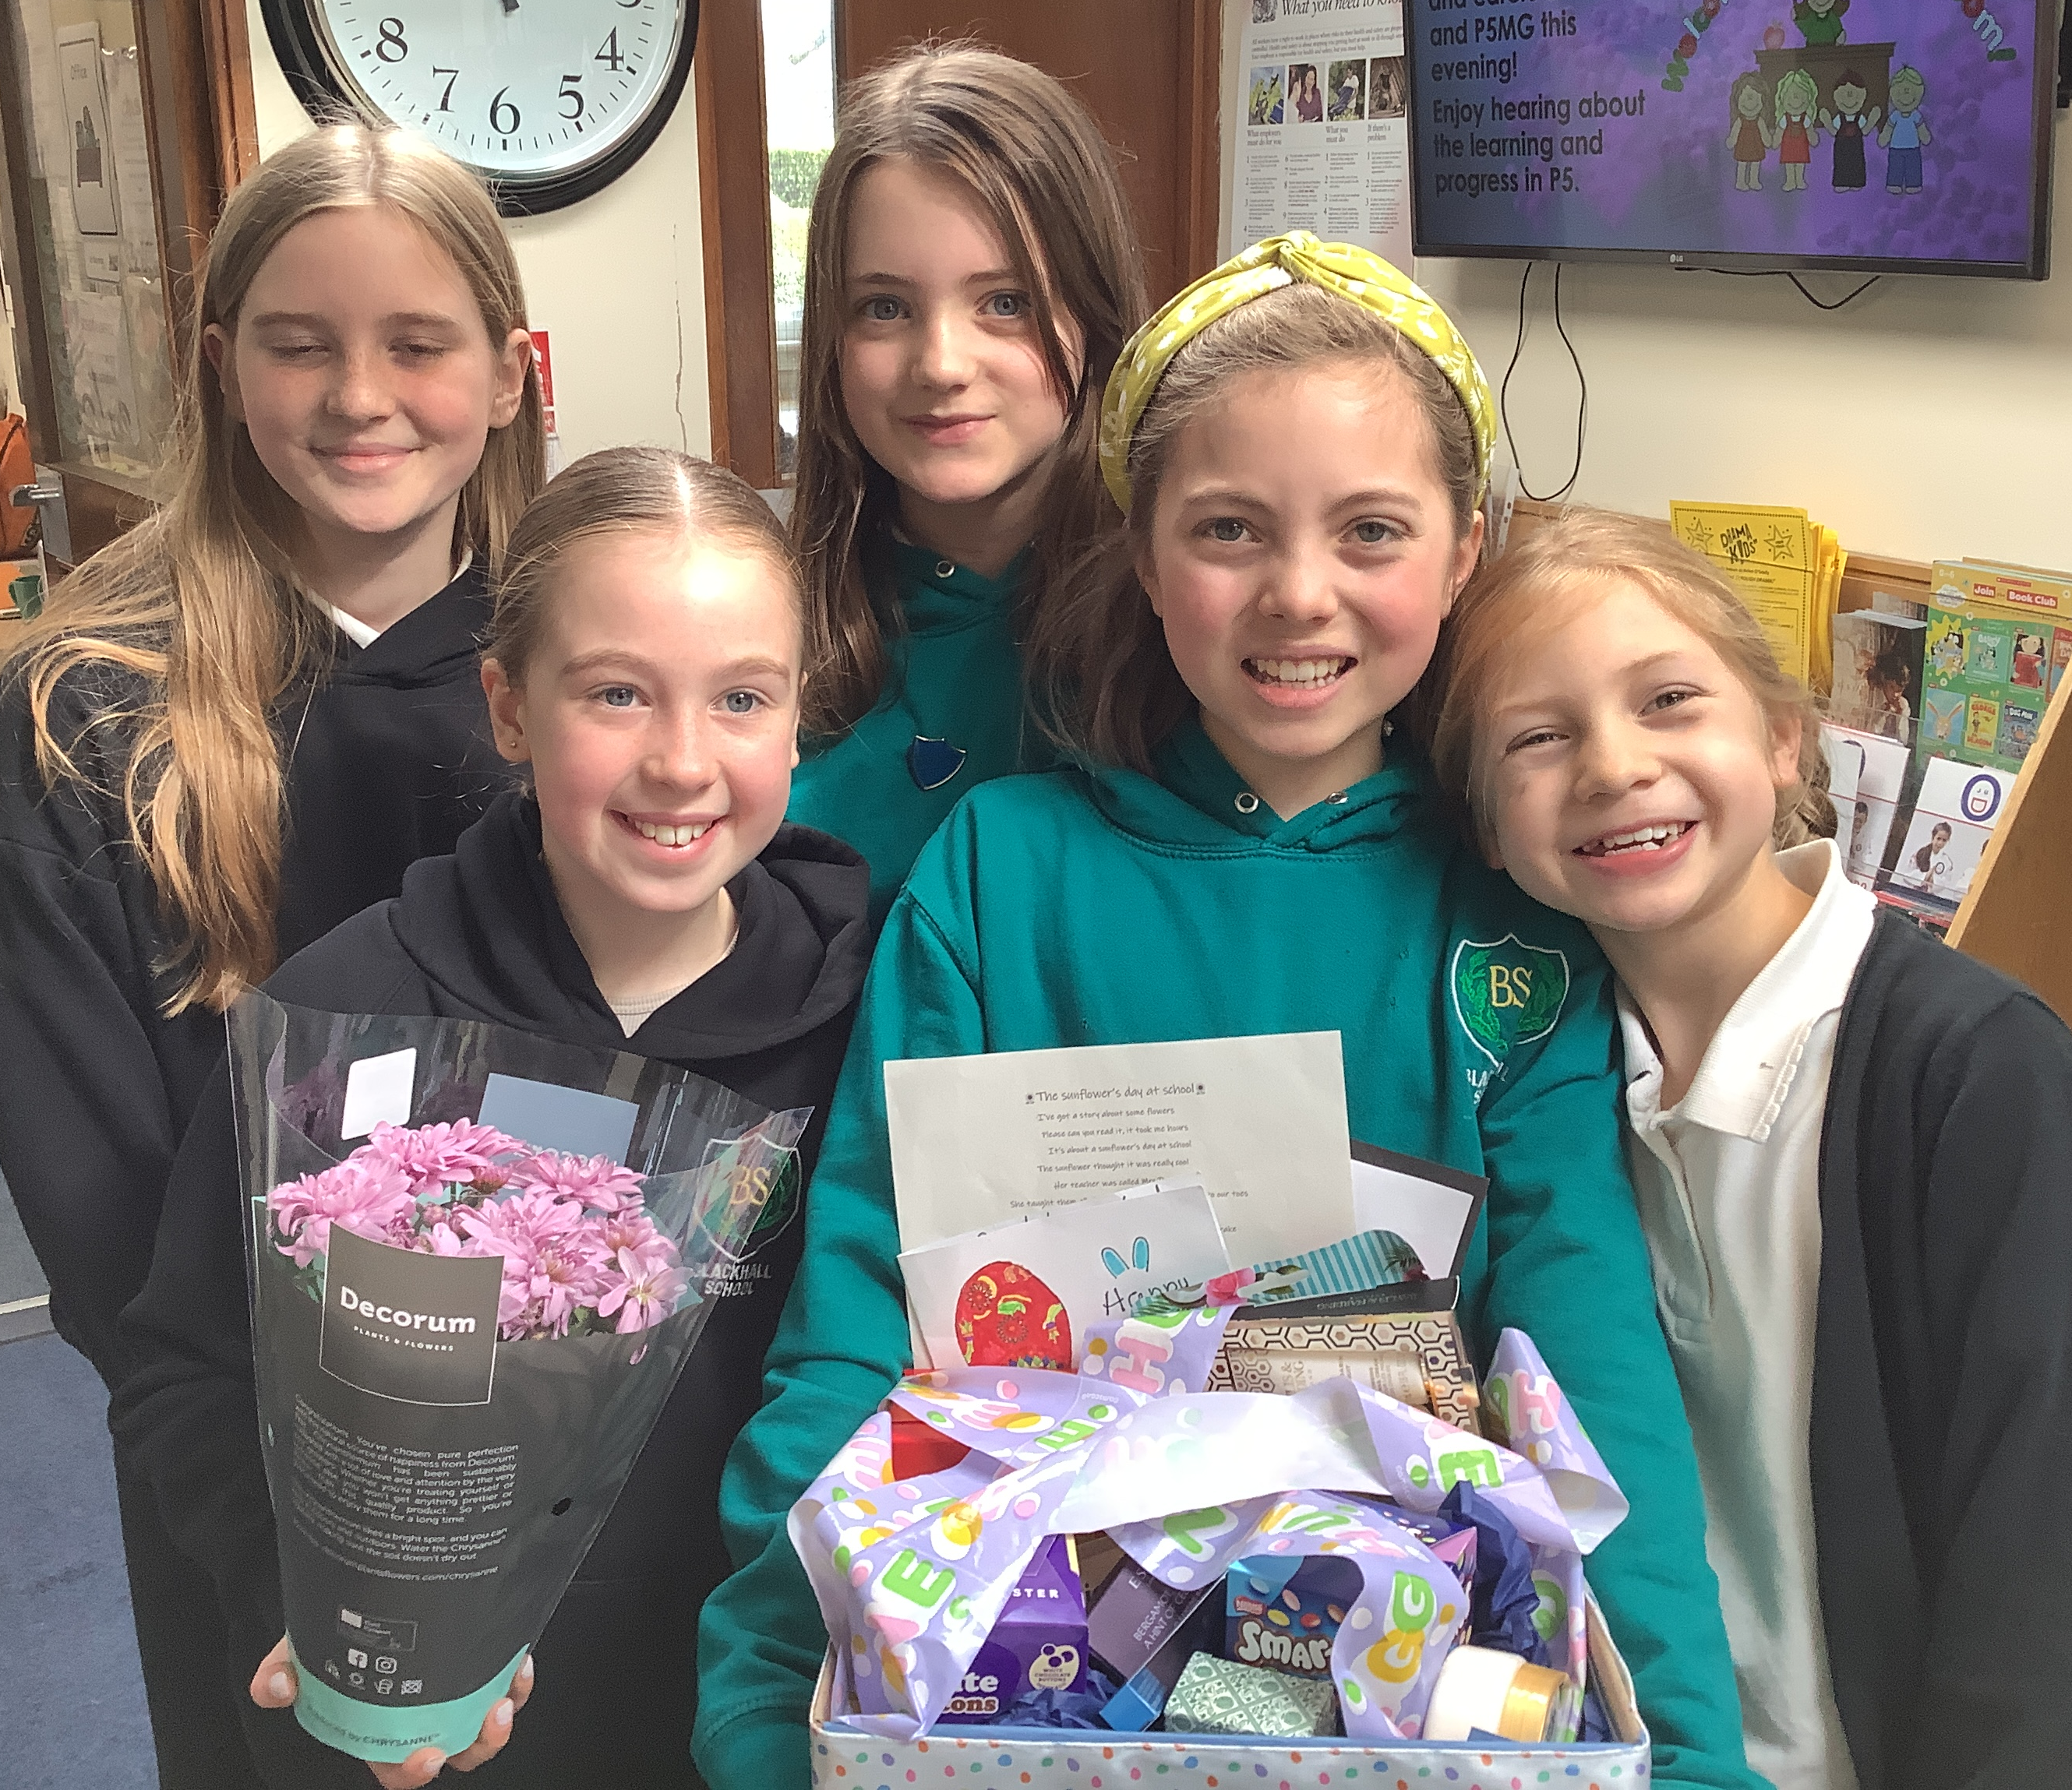
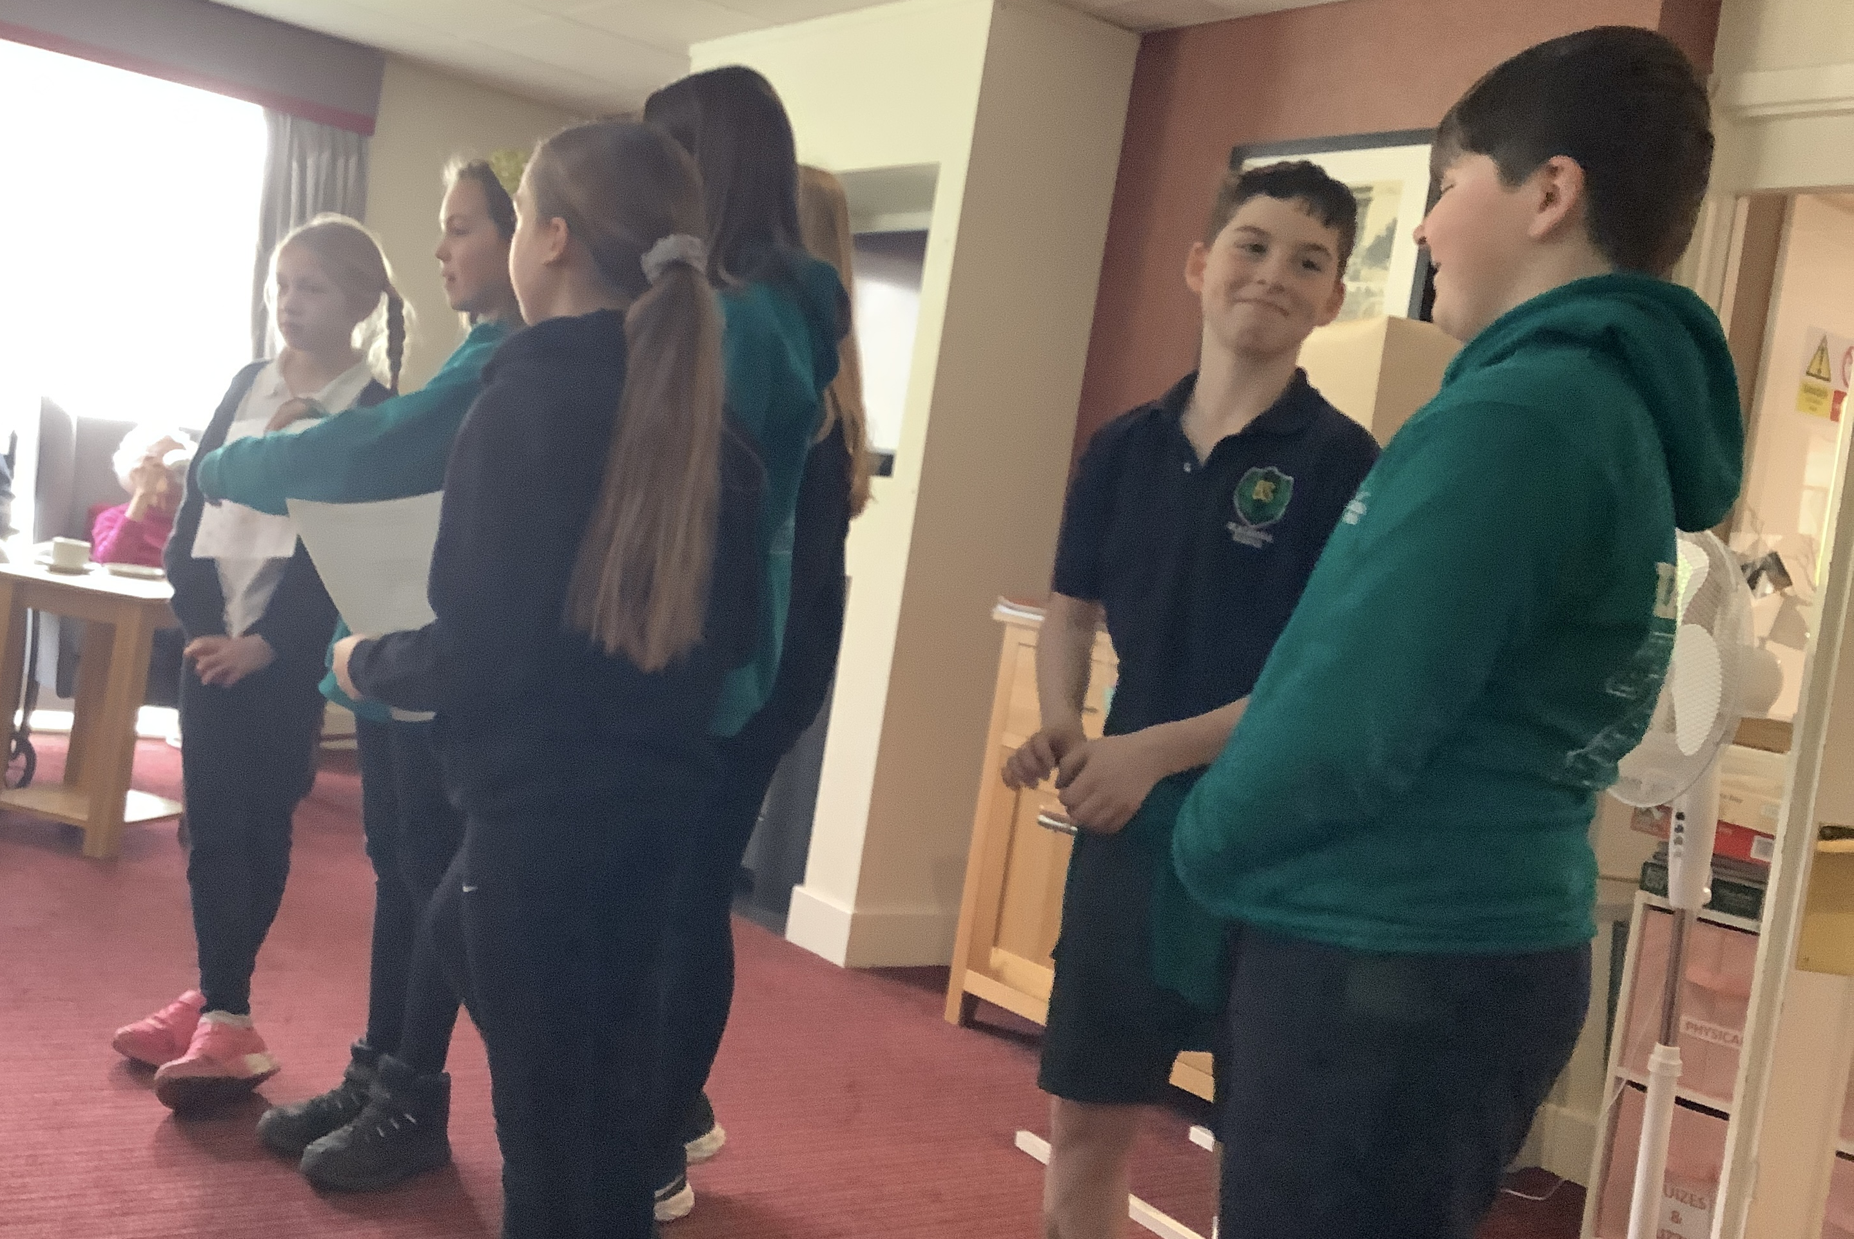
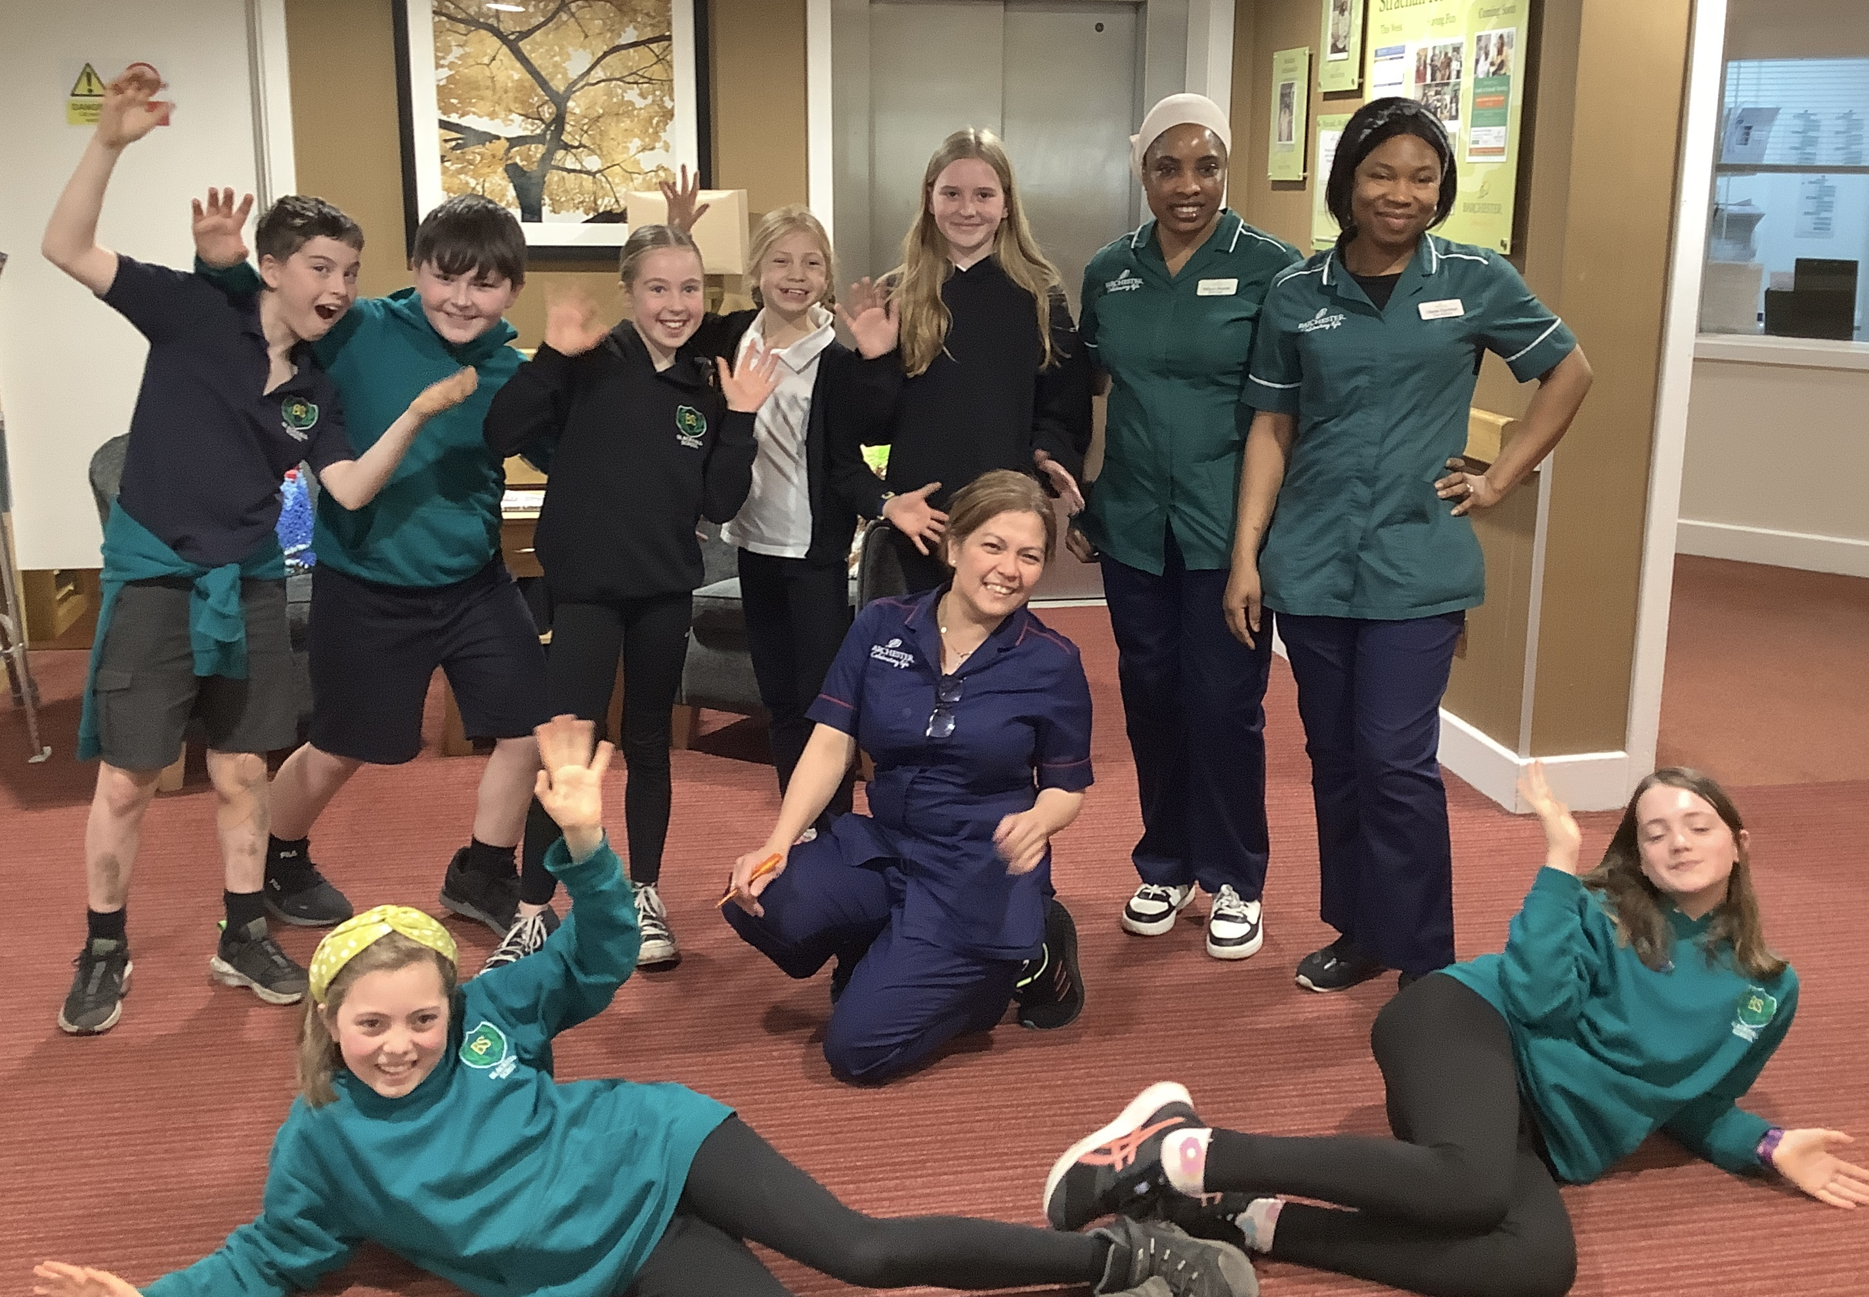
We visited Strachan House
Notes:
Alfie – This term, we have been visiting Strachan House Care Home to give some time to our neighbours in there. We took some gifts that had been donated and heard lots of stories and played games when we were there.
Theo - The residents were happy to see us. I don’t think they were even bothered about the gifts we brought! (Although Bob made a Bee Line for the chocolate!)
It was really great to feel so welcomed!
Kyla - We all have so much to give – not ‘stuff’ but time, talents, support, energy and help.
These things don’t cost anything but are priceless.

Slide 53
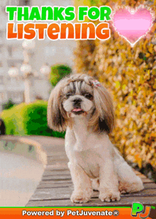
Thank you for listening!
Notes:
Ruby - We hope you have all enjoyed our story and our songs this morning.
We would also like to say a great big thank you to our teachers and all the staff at our school who make it such an amazing place for us to learn.
Alfie – There’s someone else who has given a lot to Blackhall over the years. We would like to give a little something to that person now.

Slide 54

Thank you, Mrs Ashcroft!
Notes:
Lewis – Tomorrow is not only the end of our spring term, it is also Mrs Ashcroft’s last day at Blackhall. We are very sad to be saying goodbye to Mrs Ashcroft. She is always so helpful in the office or in the playground – or when our teachers just need that extra glue stick..!
India – We asked what words best described Mrs Ashcroft for us. Here is what we said. (Heart-shaped Wordle)
Esme – Lots and lots of people said “helpful” and “always smiling.” We got quite a few, “classy” as well! We will miss Mrs Ashcroft in our school and hope she will come back to visit us often.
Gus – We would like to dedicate a song to you, Mrs Ashcroft, and hope you know you can always count on us – just like we have counted on you!

Slide 55
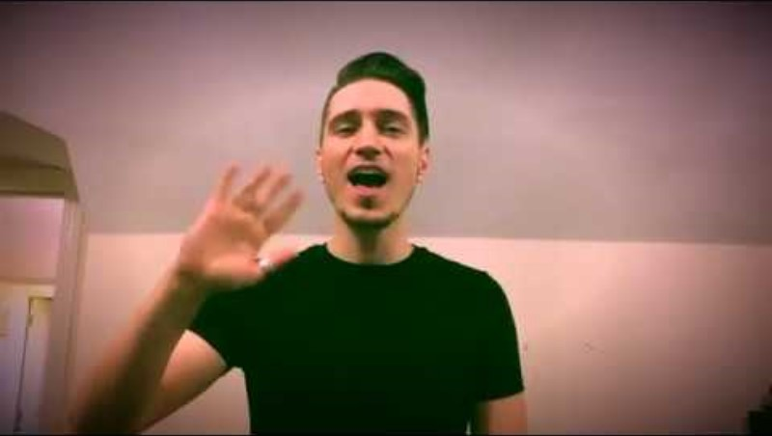
Song for Mrs Ashcroft – “Count on Me”
Notes:
Whole school sing for Mrs Ashcroft
(India and Lewis to take flowers to Mrs Ashcroft, at the end of the song.)

Slide 56

Message from Fergus
Notes:
Theo –Thank you Fergus and others who have invited us here again today for this assembly.
We are so lucky to have you and your team supporting us.
Now, Fergus is going to share a few words with us all

Slide 57
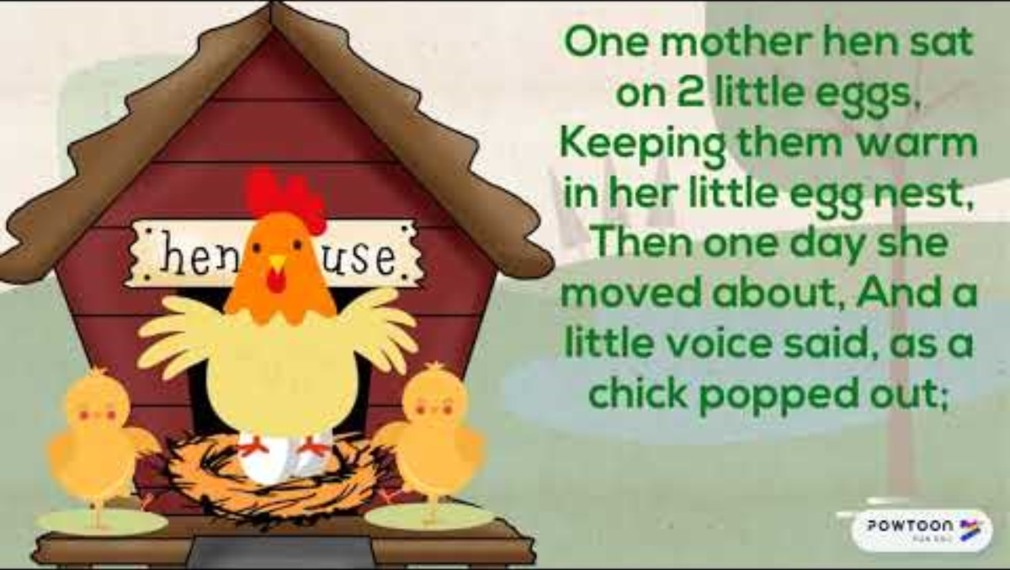
Spring Chicken!
Notes:
Isla - Thank you again, Fergus. We hope you have all had a chance to think about how meaningful it is to be ‘giving’ types of people.
Ewan - Have a lovely break when it comes and we will be back to launch into our very last term of this school session on Tuesday, 22nd April.
India – Thank you to all our Parents and Carers who have joined us this morning. Let’s finish by singing, “Spring Chicken”. Parents and Carers, you probably know this. Join in - and enjoy the actions!

Slide 58

Farewell message from Fergus

