Slide 1

Learning and Teaching Policy at Blackhall
Thursday, 16th January 2025

Slide 2
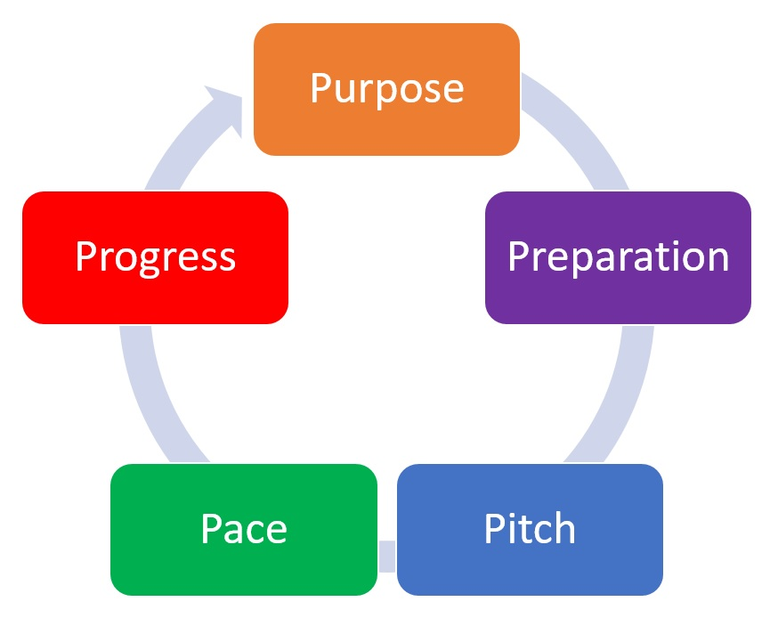
Learning and Teaching - Aims
Teachers:
Agree worthwhile outcomes
Set high expectations
Know your learners
Know your impact on the learning

Slide 3
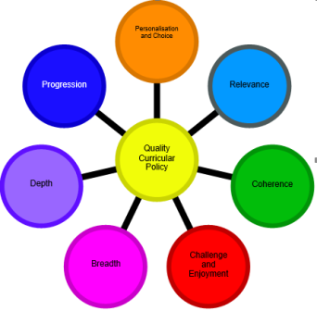
Learning and Teaching at Blackhall
Agree Worthwhile Outcomes (PREPARATION)
Ensure learning intentions are clear, shared and relevant. (What are we learning and why?)
Success Criteria to be discussed (How are we going to show we have learned?)
Learning is prepared and differentiated to match learners’ needs.
Link to other/former learning where possible.
Notes:
Learning intentions clearly linked to Es and Os
Prepared, differentiated resources to support and extend

Slide 4
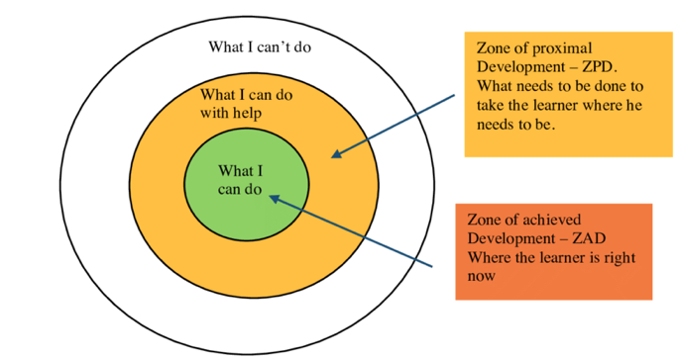
Learning and Teaching at Blackhall
Set High Expectations (PACE)
We will encourage pupils to take responsibility for learning and emphasise the importance of trying.
Differentiated and AiFL strategies will identify the next step.
Find the gap between what a pupil can do without help and what a pupil can achieve with some scaffolding/support. (ZPD)

Slide 5
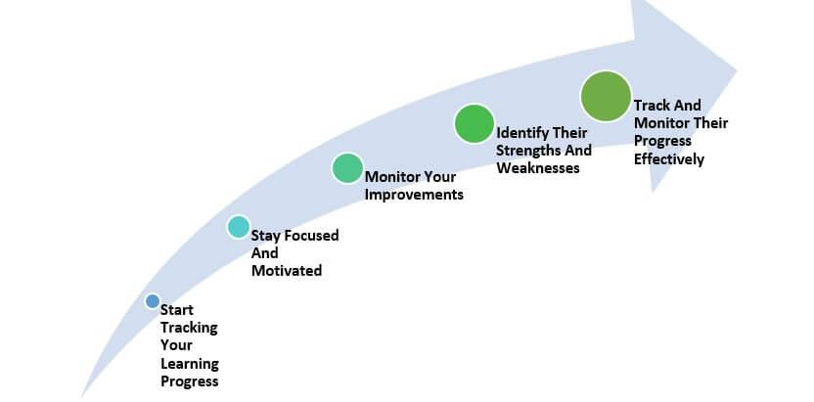
Learning and Teaching at Blackhall
Know Your Learners (PITCH AND PROGRESS)
Our teachers will build on prior knowledge – what we already know, to ensure PROGRESS.
Pupil are involved in choosing learning contexts. What do you want to learn?
Learners and learning will be tracked through Attainment Meetings; ASN Discussions; Professional Dialogue; and Teacher Professional Readings.
Folio Jotters – 2 Folio Weeks each school year – help to track progress over time.
Notes:
AifL - Something here about assessment informing next steps.
Learners have a clear picture of their own progress and next steps. Learners are aware of targets relevant to their stage and challenges to upskill their learning.
Tracking progress – Folio Jotters

Slide 6

Learning and Teaching at Blackhall
Know Your Impact (PURPOSE)
We strive to add value to the learning.
We want our learners to be curious; to develop a skillset that can be carried across all learning in life.
We provide positive and timely feedback to pupil performance.
We analyse data from all assessments to inform future learning.
We reflect on the learning to inform and improve our future practice.
Notes:
Add school values to bullet point 2 – creativity, responsibility, respect, ambition and resilience – add overarching statement at top of policy
We encourage learners to share what they want to learn in topics and plan accordingly
We engage with the CEC tracker to monitor progress
We

