Slide 1


Blackhall Primary School
Parent Council AGM

Slide 2
Agenda
Annual report from the Chair
Annual report from the Headteacher
Approval of the accounts
Election of members to serve on the Parent Council
Any other competent business

Slide 3
Parent Council Chair’s Report
Moving on from the pandemic…
Embedding the parent/carers “ways of working”
Head Teacher – permanent appointment
Pupil Council
New school finance committee
Subsidy towards the pantomime
ASN resources on website
Strikes…
Amazing GIF filled HT reports!
Report Cards!
Parking >> sports field >> access to the community noticeboard >> using public transport for school activities >> challenges of using shared devices for more than one child >> free school meals – and impact of parents not registering on PEF >> squirrels raiding the bins and causing litter >> ParentPay lunch booking issues >>

Slide 4
Head Teacher’s Report

Slide 5

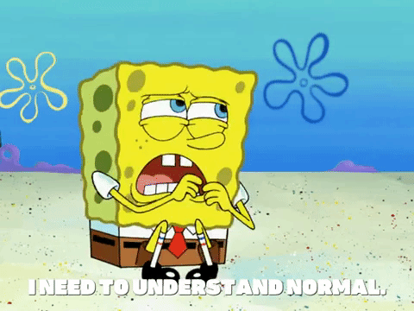
A School Year at Blackhall
August 2022 – June 2023
A full school year of “normal”!!
What did that look like?

Slide 6

Term 1
Staffing:
Acting Head Teacher – Kirsty Martin
Depute Head Teacher – Gail Middlemiss
Principal Teacher – Andrew Gardner
Bumps in the road in P3, P7 and both P6s.

Slide 7

Term 1
Looking at Formative Assessment
Introducing Spanish in P6 and P7
Considering HWB for staff and pupils
Wildlife Rangers Sessions
Community Gardening Day 1

Slide 8

Term 1
Judo Taster Sessions
Gaelic Football
Bikeability for P6
Nurture Room up and running

Slide 9








Term 1
DREAM About Travel!
Drama, Singing, Ukulele, Dancing, Art – Fun!

Slide 10
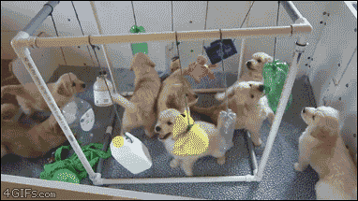
Term 2 – October - December
Parent Consultations 1 in Big Hall
P4s to Stirling Castle
Parents and Carers in to share learning
Choir to Toby Carvery!

Slide 11

Term 2 – October - December
Parents and Carers invited in for Winter Wonderland
Wildlife Rangers
Moderating the teaching of Reading
P5 Enterprise
P1 Nativity

Slide 12

Term 2 – October - December
Whole School to Pantomime!

Slide 13
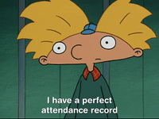
Term 3: January – April 2023
Reading Working Party to look at resources through equalities lens
Learning Cluster Maths group
NYCOS to P3
Finance Committee starts – with HT, BM, Parent/Carer, Admin
Attendance Tracking and Monitoring

Slide 14

Term 3: January – April 2023
P7 CAMP!!!
Substantive HT Appointed in February
Blackhall PS is awarded Silver Status in Rights Respecting Schools.
Attainment Meetings with SLT and Teaching staff
Risk Factory for P7s
ASN Coffee Mornings
Parents Consultations 2
P7s begin transition process to RHS
Shared Classroom Experience 2

Slide 15
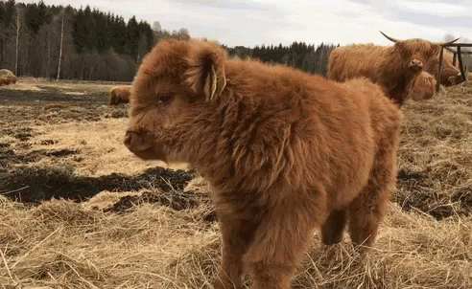
Term 3 – January to April
P6 to Sky Up Academy
Farm comes to Blackhall!
P5 Swimming
Mixing Classes
Attainment Meetings with SLT and Teaching Staff
Spring Assembly in St Columba’s Church

Slide 16


Term 4 – April to June
Scottish Opera with P6
Community Gardening Day!
Outdoor Learning
P5 to Chocolatarium
P6 to Bowling at Blackhall Bowling Club
New Report Card Format launched!

Slide 17

Term 4 – April to June
SPORTS DAY!
P7 Show – Star Warts: The Umpire Strikes Back!!
Royal Highland Show for P3-P5
STEaM Event for Parents

Slide 18

Term 4 – April to June
End of Term Assembly (Outdoors)
Meet the Teacher
P7 Fun Day to Aberdour
End of term 28th June at 1pm!

Slide 19
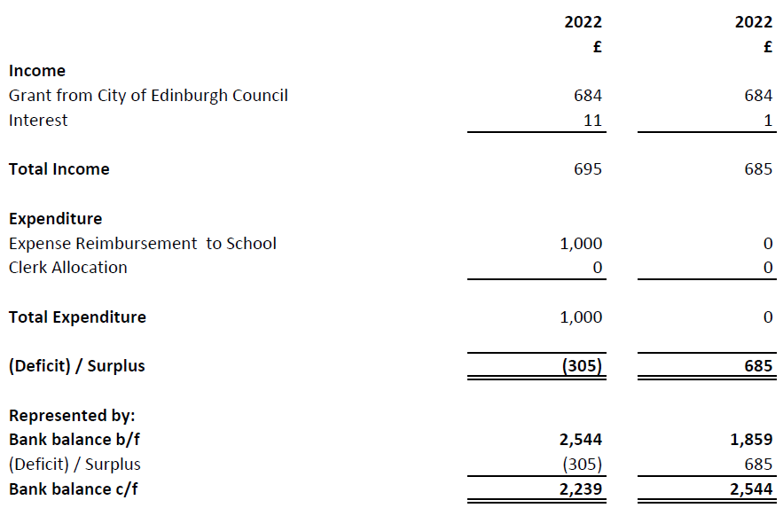
Accounts for year ended 31 March 2023

Slide 20
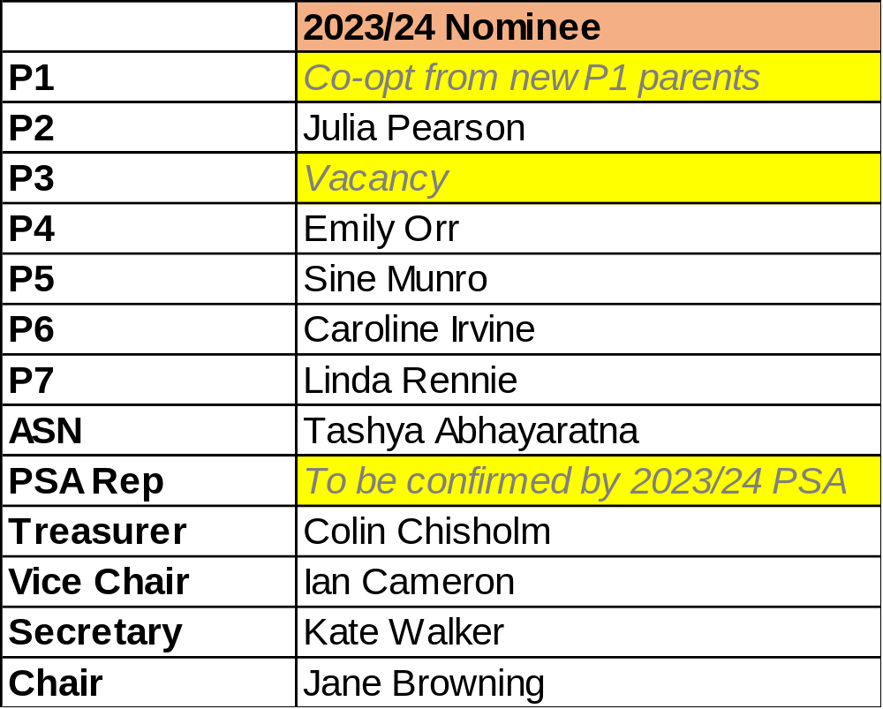
Parent Council Nominees for 2023-2024

Slide 21

Thank you …
Julia Pearson
Kate Walker
Emily Orr
Sine Munro
Nyssa Pinkerton
Linda Rennie
Ian Cameron
Jill McIntyre
Colin Chisholm
Ian Cameron
Jane Browning
To our local councillors:
Hal, Max, Jule & Vicky
To the school SLT:
Kirsty, Gail & Andrew

Slide 22

NSPCC Presentation – Keeping children safe online

