Slide 1
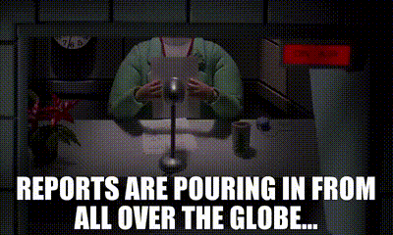

Parent Council
Head Teacher’s Report
Wednesday, 30th November

Slide 2

Staffing
SfL – Laura Adam
P7 NQT Cover and P2 Friday – Aoife Donnelly
P3M – Harriet Shortall (Thursday and Friday)
Some absence - but still on budget for cover.

Slide 3

Staffing Changes coming…
PSO – advertised and interviewing next week
PSA – vacancy declared but currently covered

Slide 4

Since we last met…
Parent Consultations in the Big Hall
Learning through Play in P5
Nurture Groups are up and running
Choir has started
Community Gardening Day
Students are returning
Pace and Challenge
National Discussion
Formative Assessment (Learning Community)
Re-establishing community links
PSA Disco
Website continues to be upgraded: Launched ASN Newsletter and updated tab on website

Slide 5

Attendance
Attendance is generally very good at Blackhall
If you require more than 2 weeks absence from school, this must go through the authority.

Slide 6
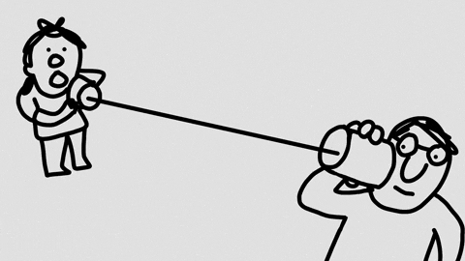
Communication
Weekly newsletter updates continue
Considering Twitter and its purpose – to be discussed with staff and parents
Reminder to parents to send all communication through Admin account

Slide 7
Attainment Data
We have to submit figures in November, March and May.
November and March are predictions.
Current Stage | School | Session | Tracking Period | Reading On Track | Reading Not on Track | Writing On Track | Writing Not on Track | L&T On Track | L&T Not on Track | Numeracy On Track | Numeracy Not on Track
P1 | Blackhall PS | 2022 | 5 | 80.85% | 19.15% | 74.47% | 23.40% | 95.74% | 4.26% | 85.11% | 14.89%
P2 | Blackhall PS | 2022 | 5 | 82.61% | 6.52% | 82.61% | 6.52% | 89.13% |  | 89.13%
P3 | Blackhall PS | 2022 | 5 | 83.33% | 16.67% | 75.93% | 24.07% | 94.44% | 5.56% | 87.04% | 12.96%
P4 | Blackhall PS | 2022 | 5 | 85.96% | 14.04% | 77.19% | 22.81% | 92.98% | 7.02% | 91.23% | 8.77%
P5 | Blackhall PS | 2022 | 5 | 88.31% | 10.39% | 83.12% | 15.58% | 96.10% | 2.60% | 85.71% | 12.99%
P6 | Blackhall PS | 2022 | 5 | 84.62% | 15.38% | 80.00% | 20.00% | 90.77% | 9.23% | 89.23% | 10.77%
P7 | Blackhall PS | 2022 | 5 | 88.00% | 12.00% | 86.67% | 13.33% | 92.00% | 8.00% | 88.00% | 12.00%
Notes:
November 2020 (City of Edinburgh)–
P1 Reading - 79% Writing – 77% L+T – 83% Numeracy – 81%
P4 Reading – 75% Writing – 70% L+T – 86% Numeracy – 75%
P7 Reading – 81% Writing – 76% L+T – 86% Numeracy – 77%

Slide 8
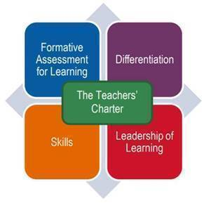
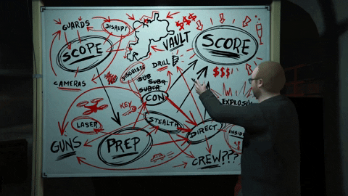
School Improvement Plan Priorities
Working Parties;
Spelling – resources and policy
Reading – resources and strategies for teaching skills
Written Report Format – parents and carers consultation requested

Slide 9

Finance Committee
First Finance Committee scheduled for 5th December.
Many thanks to Sine Munro
Planned spending on resources
P1 and P2 play resources

Slide 10
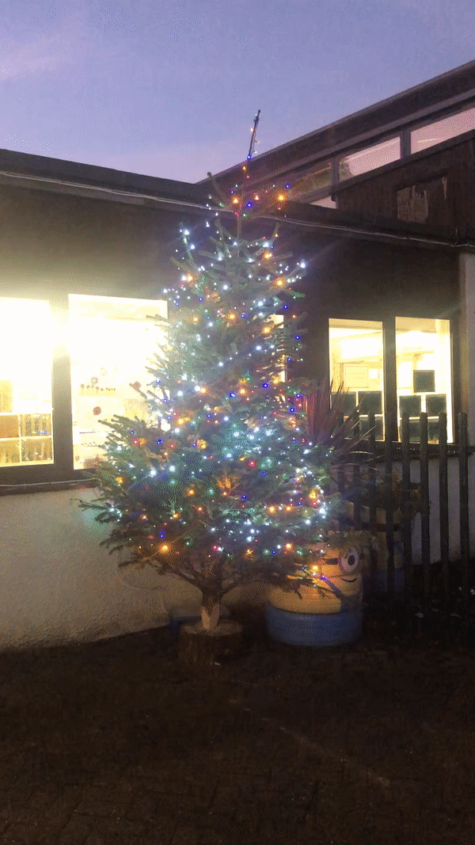

And coming up…
Winter Wonderland Art
End of Term Church Service
Walking in a Winter Wonderland
PC Chair meets Pupil Council – “gird your loins!”
Council Savings expected in the new year.
Sharing practice with cluster community
Digital learning continues – including cluster discussion.
Rights Respecting Schools – Silver accreditation visit in February.
Whole School to the Pantomime!

