Slide 1

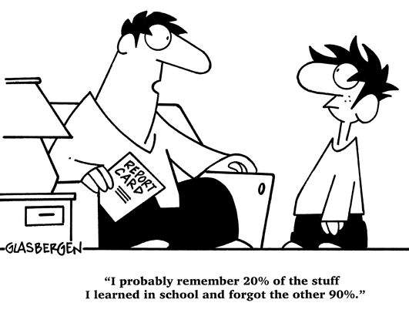
Parent Council
Head Teacher’s Report
Wednesday, 22nd February

Slide 2

Staffing
P4M – Andrew Gardner leading class in the absence of Sarah Mitchell.
Budget cover is tight.

Slide 3


Staffing Changes coming…
Steven Smith – new Business Manager – is starting with us on 13th March. Aimee Gerrard has been filling in as Acting Business Manager.
PSA – vacancy still not filled.
Jo Palfrey is retiring at the end of this term – Easter. An email has gone out to P2P parents and carers.

Slide 4

Budget and Staffing Projection
School dropping by a class next session and falling below 400 pupils.
Significant impact on school budget.
‘Extras’ have to be carefully considered

Slide 5

COSD – Cost of the School Day
We must keep costs to a minimum – zero where possible.
Free school meals means those with Free School Meals Entitlement are not applying.
This affects the amount of budget allocated to the school.

Slide 6

School update
Christmas/Winter Events were a big success – Panto in particular
Whole school service in St Columba’s Church
New format for Reporting to Parents has been in consultation
Teaching staff taking a closer look at reading and how it is taught in our school.
Wider Achievements are being celebrated

Slide 7
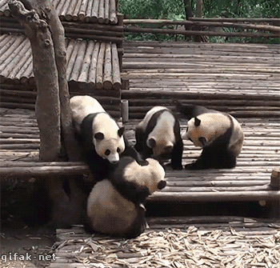
School update
Gaelic Football, swimming, judo, cycling…
P6 Trip to Sky Up
Blackhall Blether Podcast is firmly established
P7 Camp to Lagganlia was amazing!
Transition events continue for P7 pupils: Maths development and activities

Slide 8

And coming up…
March Happiness Challenge!
World Book Week/Day
Parents/Carers in to share learning
Farm to Food Visitors! Coming to a field near us..!
Rights Respecting Schools Silver Award evaluation

Slide 9
And coming up…
Attainment meetings with staff
Tricky Ricky Magic Show P1-3 (PSA) 8th March
Shared Classroom Experience – staff groups
Parent Consultations – 21st and 23rd March

Slide 10

School Building and Surrounds
Decking removed from front of school
Pupil Council are tasked with collating ideas and plans (grants are available)
Astro plans are ongoing.

Slide 11

Attendance linked to Attainment
Focus on attendance continues across the authority
Whether or not an absence is “authorised,” it is still marked as an absence.

Slide 12
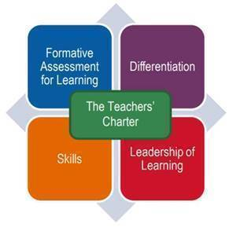
School Improvement Plan Priorities
Working Parties;
Spelling – resources and policy – improvements are being noted by staff and pupils.
Reading – resources and strategies for teaching skills being reviewed at this week’s CAT (Collegiate Activity Time) session
Written Report Format – parents and carers consulted. Final formats being agreed and drafted.

Slide 13

School Improvement Plan Priorities
Working Parties;
Continuing with Learning Cluster Improvement Plan – using Formative Assessment and Data to improve learning and teaching.

Slide 14

Finance Committee
Finance Committee has now met twice.
Many thanks to Sine Munro
Planned spending on resources
Sine sourced a possible grant application for front of school improvements.

Slide 15





Need to know what’s happening?
Weekly school newsletter is a good place to start…

Slide 16
Attainment Data
We have to submit figures in November, March and May.
Current Stage | School | Session | Tracking Period | Reading On Track | Reading Not on Track | Writing On Track | Writing Not on Track | L&T On Track | L&T Not on Track | Numeracy On Track | Numeracy Not on Track
P1 | Blackhall PS | 2022 | 5 | 80.85% | 19.15% | 74.47% | 23.40% | 95.74% | 4.26% | 85.11% | 14.89%
P2 | Blackhall PS | 2022 | 5 | 82.61% | 6.52% | 82.61% | 6.52% | 89.13% |  | 89.13%
P3 | Blackhall PS | 2022 | 5 | 83.33% | 16.67% | 75.93% | 24.07% | 94.44% | 5.56% | 87.04% | 12.96%
P4 | Blackhall PS | 2022 | 5 | 85.96% | 14.04% | 77.19% | 22.81% | 92.98% | 7.02% | 91.23% | 8.77%
P5 | Blackhall PS | 2022 | 5 | 88.31% | 10.39% | 83.12% | 15.58% | 96.10% | 2.60% | 85.71% | 12.99%
P6 | Blackhall PS | 2022 | 5 | 84.62% | 15.38% | 80.00% | 20.00% | 90.77% | 9.23% | 89.23% | 10.77%
P7 | Blackhall PS | 2022 | 5 | 88.00% | 12.00% | 86.67% | 13.33% | 92.00% | 8.00% | 88.00% | 12.00%
Notes:
November 2020 (City of Edinburgh)–
P1 Reading - 79% Writing – 77% L+T – 83% Numeracy – 81%
P4 Reading – 75% Writing – 70% L+T – 86% Numeracy – 75%
P7 Reading – 81% Writing – 76% L+T – 86% Numeracy – 77%

